Slide 1

Diabetes Predictions from CDC 2015 & 2021 BRFSS Survey Data
DU Project 2 – Team 1 (Jeff Flachman, Elia Porter, Ava Lee)

Slide 2

Executive Summary – Project Goals
Objective
Analyze factors contributing to diabetes prevalence in the US
Determine predictive value of these factors
Industry Relation
Relevant to healthcare industry, focusing on predictive analytics for chronic disease management
Addresses public health by identifying risk factors and potential interventions
This Photo by Unknown Author is licensed under CC BY-SA
Notes:
Ava

Slide 3
Understanding diabetes
Risk Factors:
Age: Increased risk for individuals over 40
Family history: Higher risk with diabetic relatives
Ethnicity: Higher prevalence in certain races
Inactivity: Lower physical activity increases risk
Weight: Overweight and obesity are major risk factors
Blood pressure: High BP can lead to insulin resistance
Cholesterol: High levels increase diabetes risk
Smoking: Smokers have a 30-40% higher risk of developing diabetes
Indicators/Symptoms:
Frequent urination, excessive thirst, increased hunger, unintentional weight loss, fatigue, blurred vision, slow-healing wounds, itchy skin, infections, unusual sensations
Notes:
Ava

Slide 4
Data Source, Selection, & Collection Process
2015 Dataset:
UCI/Kaggle Dataset
Focused on 21 relevant features
2021 Dataset:
Raw data pulled directly from CDC
Expanded to 36 features after cleaning and processing
Source:
2015 BRFSS dataset from UC Irvine Machine Learning Repository
2021 BRFSS dataset from CDC
Reason for Choice:
Comprehensive annual survey data with relevant health and behavioral information
BRFSS provides a large sample size, enhancing the reliability of predictive models
Notes:
Elia

Slide 5
data Cleanup & Exploration Process
Exploration Techniques:
Automated processing of CDC codebooks to extract relevant features
Evaluated features for relevance to diabetes risk
Feature to Target Correlation
No single feature had strong correlation to target
Feature to Feature correlation
Found and removed duplicate features
Feature Selection:
Key features selected based on relevance to diabetes analysis
Dropped unknown/refused responses
Scaled certain values (e.g., weight from kg to standard units)
Transformed numeric responses (e.g., converting exercise days)
Notes:
Elia

Slide 6

How Did We Achieve Our Project Goals?
Developed Configuration Controlled Pipelines:
Codebook Pipeline:
Read codebook from CDC
Pulled all 300+ feature descriptions and provided a report for evaluation
Report used to select features applicable to diabetes risk factors
Data Preparation Pipeline:
Read data for CDC or Downloaded zip
Applied additional feature transformation (imputation): feature scaling, and dropped rows with poor data quality
Model Execution Pipeline:
Applied various imbalance methods: binary data, scaling and sampling methods
Trained models
Collected metrics
Generated performance report
Optimization Pipeline:
Applied optimization methods with specified datasets and models
Steps Taken:
Used existing 2015 dataset and also evaluated, and cleaned 2021 survey data
Defined two target variables:
0/1/2 (no diabetes, pre-diabetes, diabetes)
Binary 0/1 (no diabetes, diabetes)
Applied multiple classification models to assess predictive power of each
Ranking method for Results
Optimized best models/dataset combinations
This Photo by Unknown Author is licensed under CC BY-SA
Notes:
Jeff

Slide 7

Model TRAINING & evaluation
Models Used
KNeighborsClassifier
DecisionTreeClassifier
RandomForestClassifier
ExtraTreesClassifier
GradientBoostingClassifier
AdaBoostClassifier
LogisticRegression
Overfitting
Observed a lot of overfitting with base dataset
Largely due to imbalanced data
Reduced using binary target feature, scaling techniques, and resampling methods
Evaluation Metrics:
Score & Balanced Accuracy
ROC AUC Score
Mean Squared Error
Accuracy
Precision
Recall
F1 score
Specificity
False Positive Rate
Notes:
Jeff

Slide 8

Handling Unbalanced Data
Imbalanced Data:
Original target values: 84% No diabetes, 2% Pre-diabetes, 14% Diabetes
Binary target values: 86% No diabetes, 14% Diabetes
Sampling Methods:
RandomOverSampler
RandomUnderSampler
ClusterCentroids
SMOTE
SMOTEENN
Note: Applied to Binary target with StandardScaler
Simplified Target Variable:
0/1/2 (no diabetes, pre-diabetes, diabetes)
Binary 0/1 (no diabetes, diabetes)
Outcome:
Binary target with StandardScaler and SMOTEENN or RandomUnderSampler provided the smallest dataset and was used in the optimization phase for efficient training
Notes:
Jeff

Slide 9
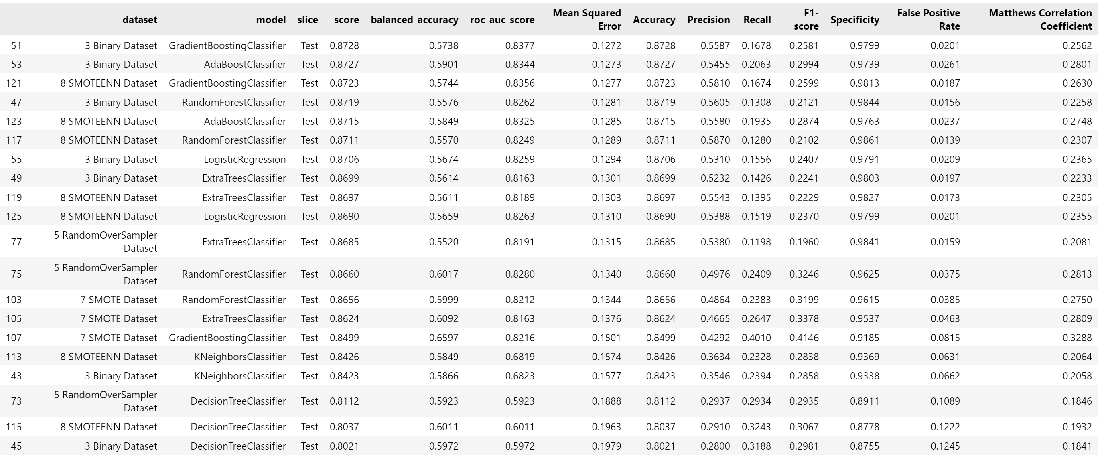
Ranking Results by Accuracy Score for Test slice

Slide 10
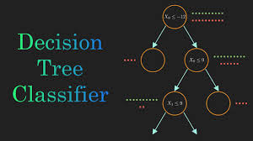
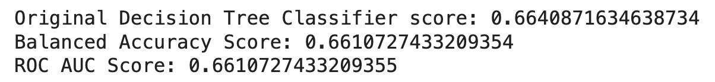
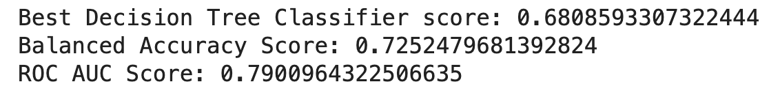
Optimization & Hyperparameter Tuning
Decision Tree Classifier + Randomized Search CV
Sampled a fixed number of parameter settings from specified ranges for efficiency
The optimization helped but not a substantial amount on this dataset
Notes:
Elia

Slide 11


Additional Research Topics With More Time
Future Work:
Expand dataset to select other years that surveyed features relevant to diabetes for broader analysis
Implement real-time prediction models for use by healthcare providers and public health officials
Try the pipeline we created to solve alternate problems
Potential Improvements:
Incorporate more advanced machine learning techniques like deep learning
Integrate data from other sources to enrich predictive models
Notes:
Elia

Slide 12

Results & Conclusions
Conclusions from 63 Model/Dataset Runs for each year. (126 total dataset/model combinations)
We achieved good accuracy. But because of imbalance struggled with Precision
Optimization helped some but did not make large gains for most models.
Top Models
GradientBoostingClassifier
AdaBoostClassifier
LogisticRegression
Top Datasets
Binary dataset with StandardScalar
Binary, Standard Scalar & SMOTEEN sampling.
Project Goal: Achieved
Successfully identified key factors contributing to diabetes prevalence.
Developed predictive models with significant accuracy and reliability.
Strong Predictive performance through:
Application of pipelines
Optimized datasets
Advanced classification models
Model performance ranking
Model Optimization
Notes:
Jeff

Slide 13
Questions

Slide 14
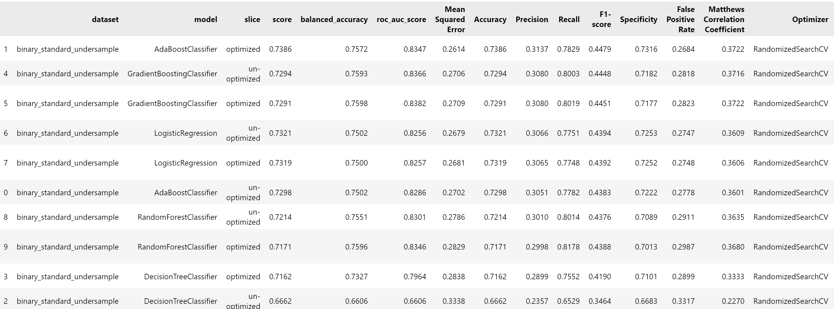
Optimization Results

Slide 15
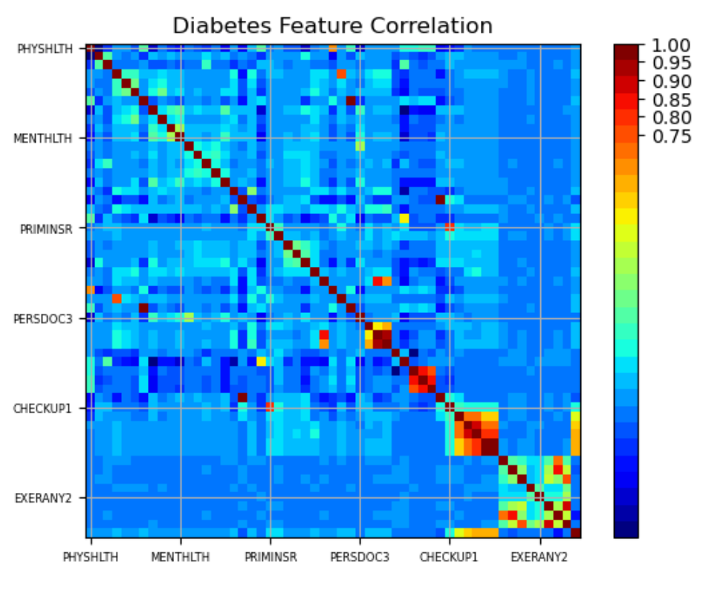
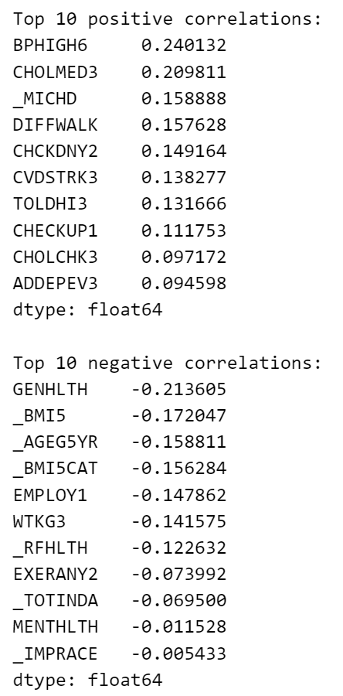
Feature Evaluation

Slide 16
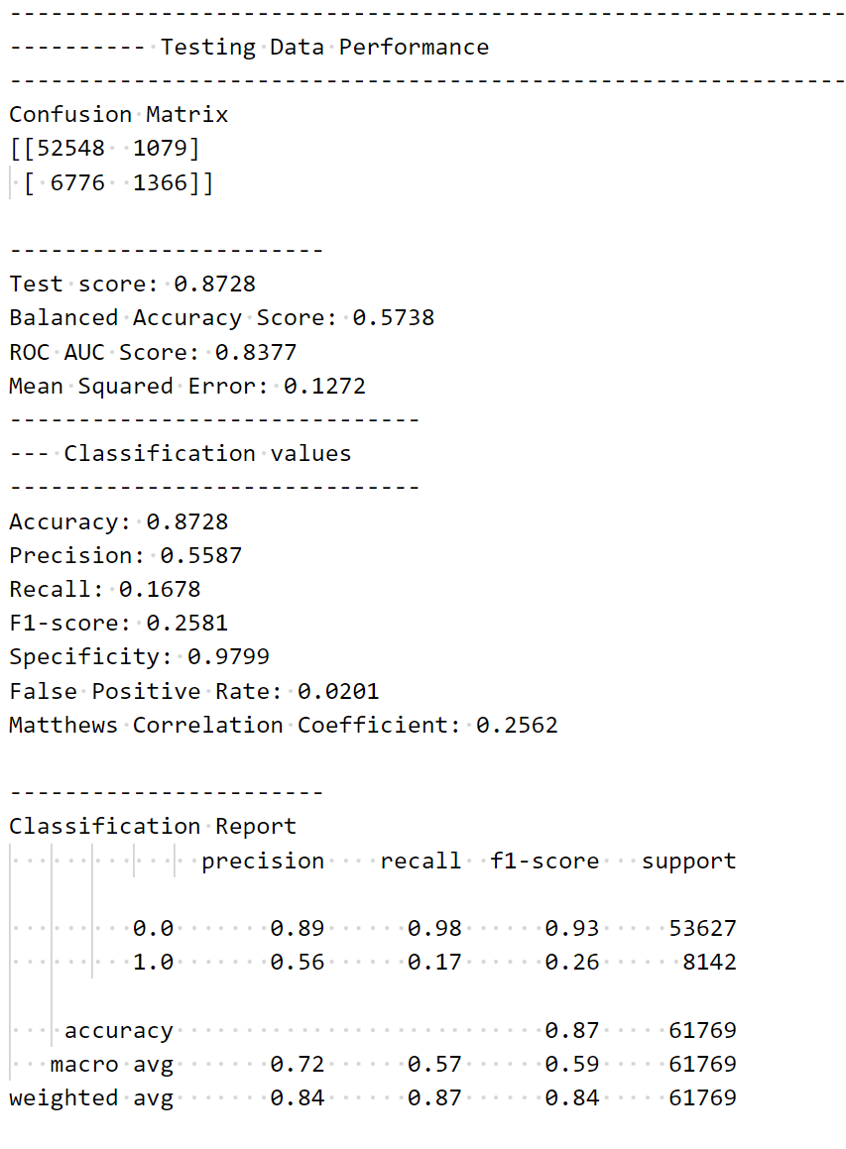
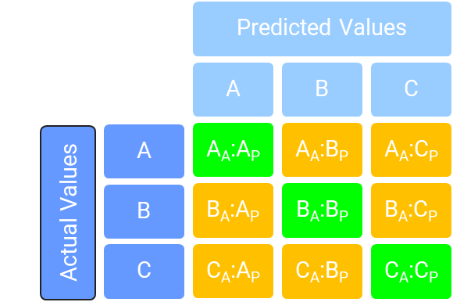
Appendix: Metrics Discussion
Evaluation Metrics:
Score & Balanced Accuracy
ROC AUC Score
Mean Squared Error
Accuracy
Precision
Recall
F1 score
Specificity
False Positive Rate
True Positive (TP)
True Negative (TN)
False Positive (FP)
False Negative (FN)

